Slide 1
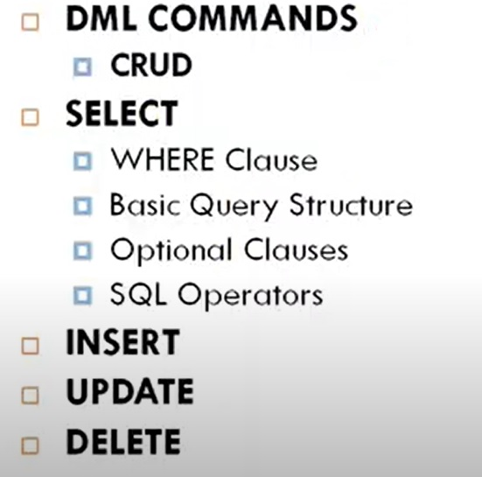
Outline

Slide 2
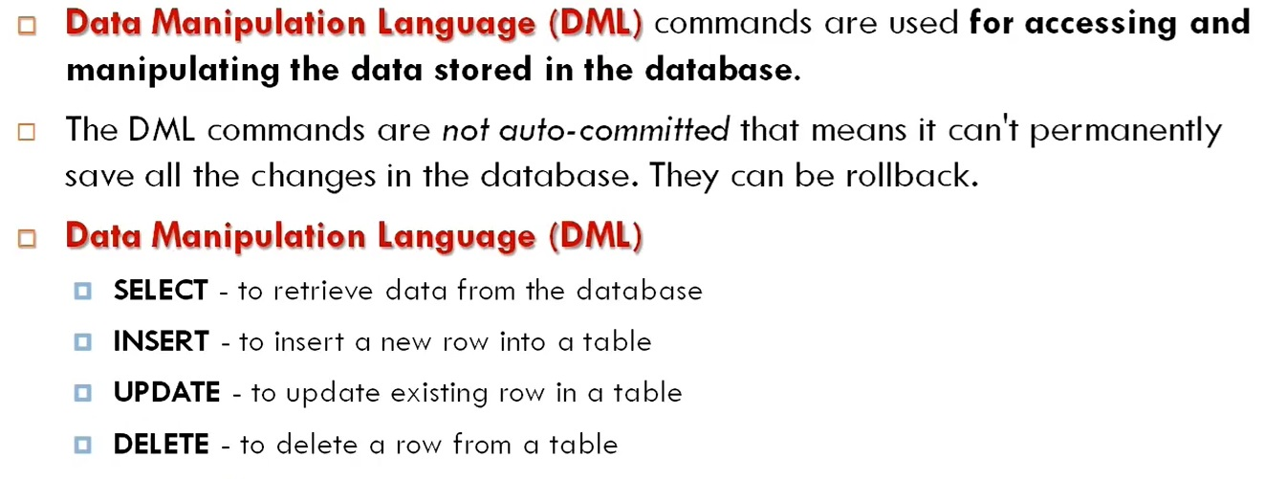

SQL : Data Manipulation Language (DML)

Slide 3
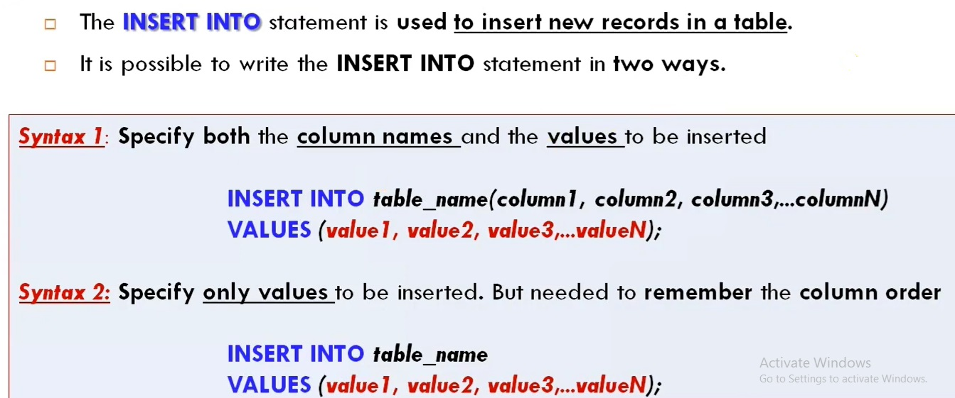
INSERT

Slide 4
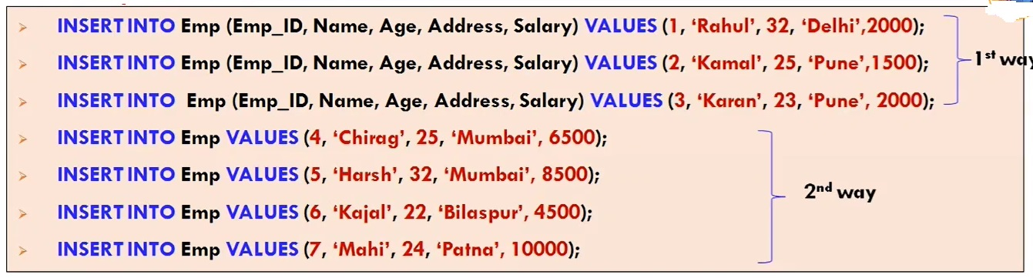
Example - INSERT

Slide 5
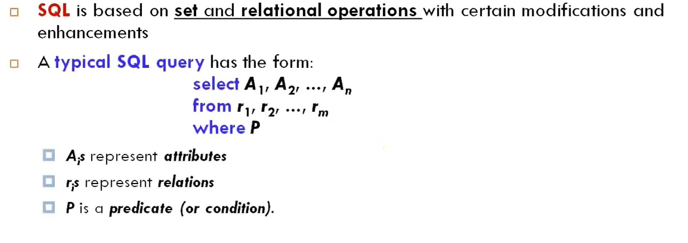
Basic Query Structure

Slide 6
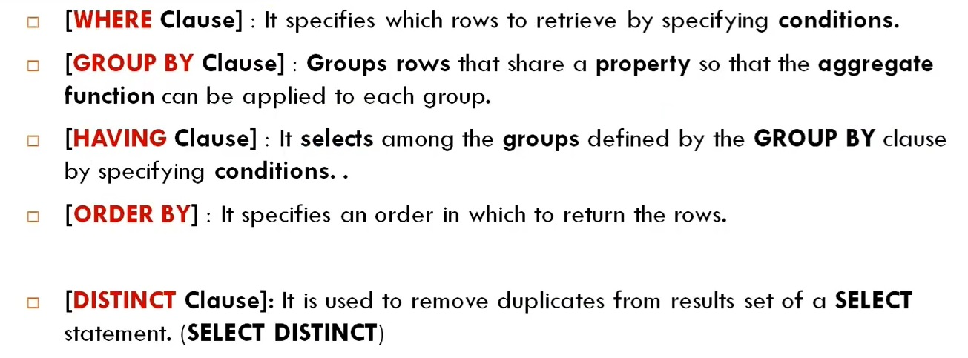
Optional Clauses in SELECT Statement

Slide 7
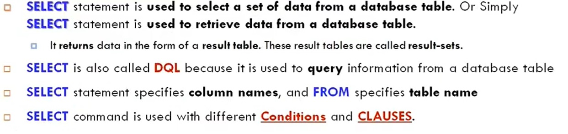
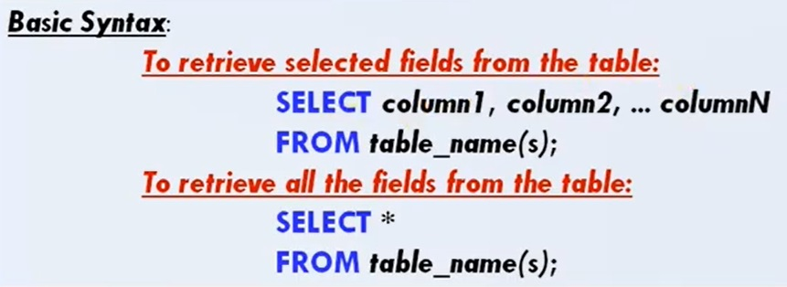
SELECT : Mostly Used SQL command/query

Slide 8
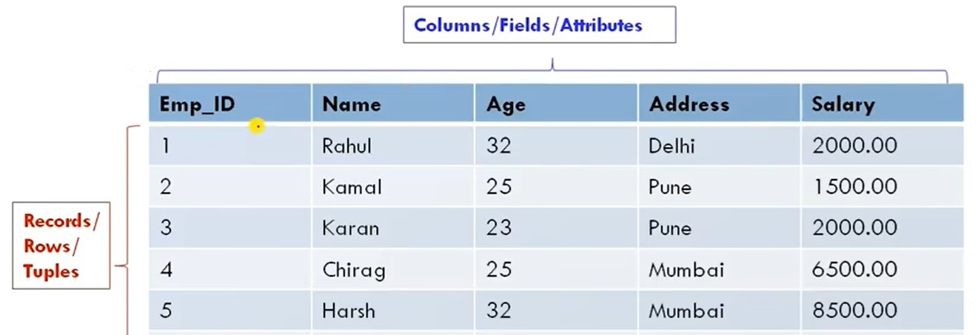
SELECT : Mostly Used SQL command/query cont..

Slide 9
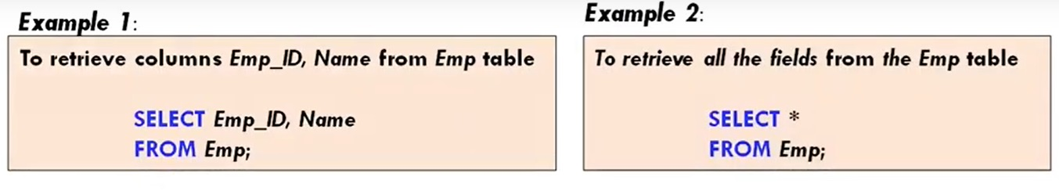
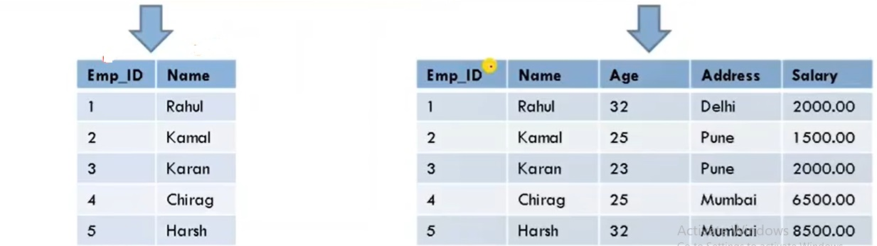
Example - SELECT

Slide 10
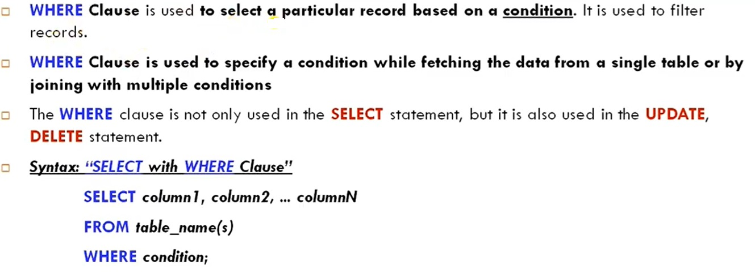
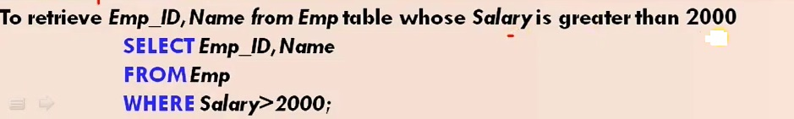
WHERE CLAUSE

Slide 11
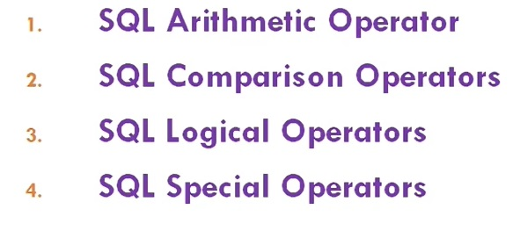
SQL Operators

Slide 12
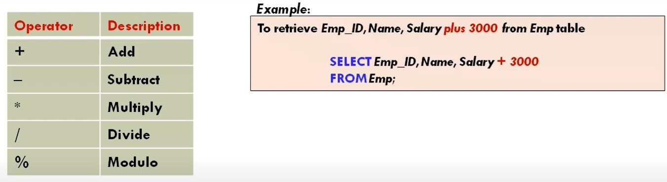
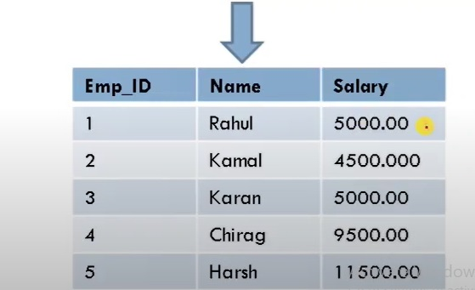
SQL Arithmetic Operators

Slide 13
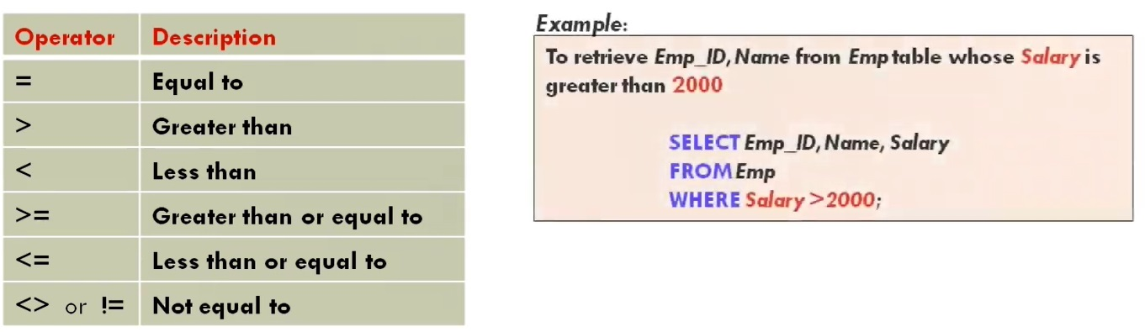
SQL Comparison Operators

Slide 14
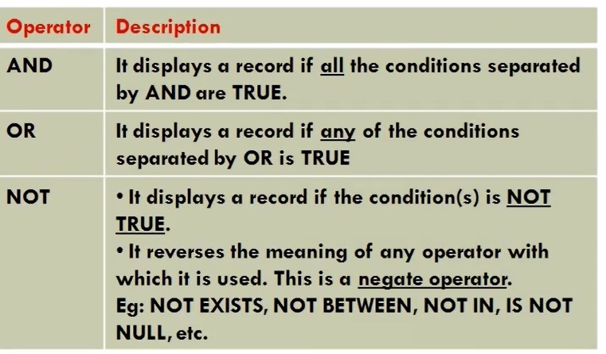
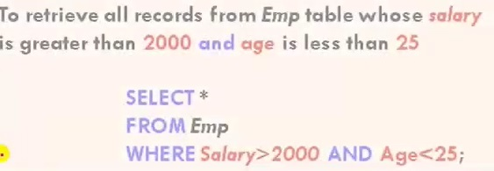
SQL Logical Operator

Slide 15
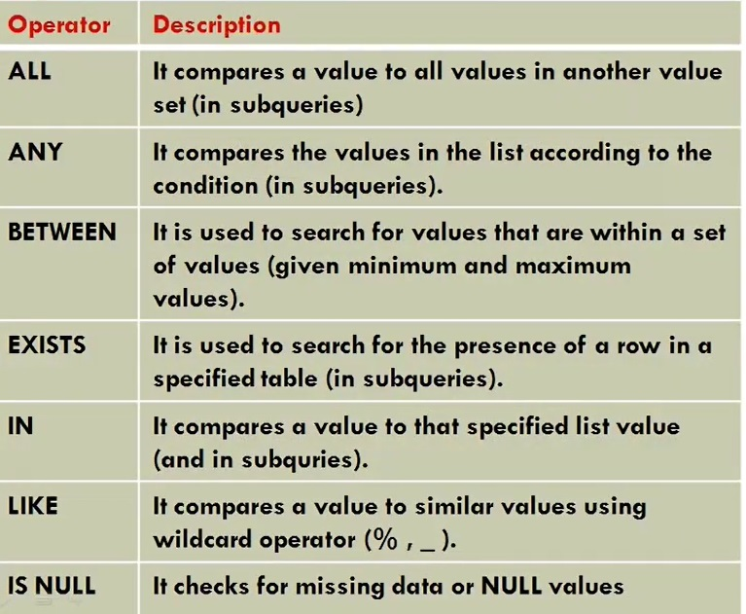
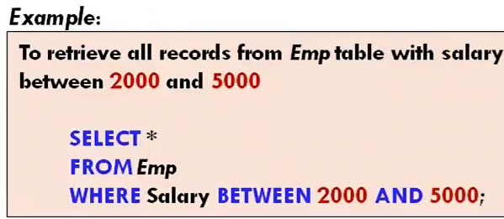
SQL Special Operators

Slide 16
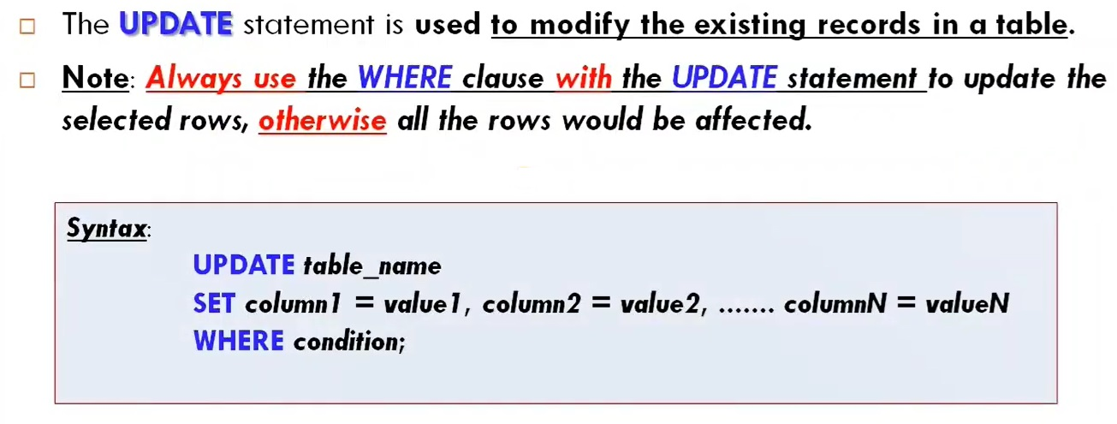
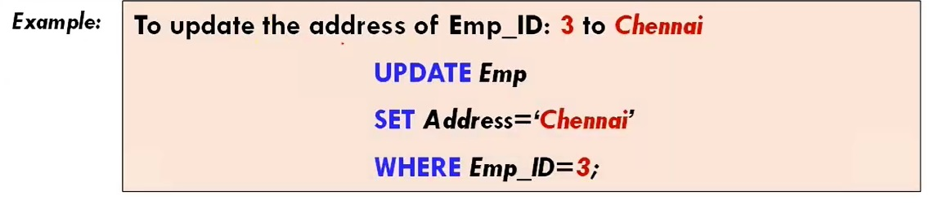
UPDATE

Slide 17
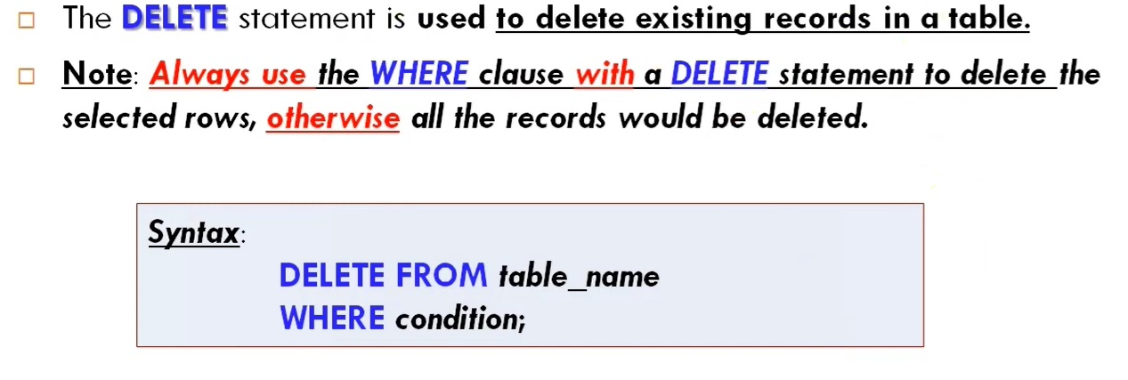
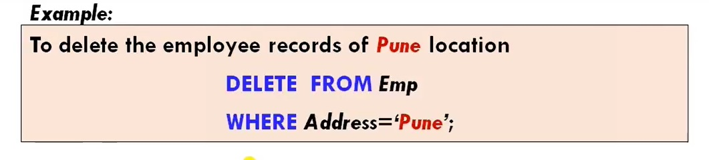
DELETE

Slide 18
Practice
CREATE TABLE Employee (
EmployeeID INT PRIMARY KEY,
FirstName VARCHAR(50),
LastName VARCHAR(50),
Age INT,
Department VARCHAR(50),
Salary DECIMAL(10, 2),
HireDate DATE,
City VARCHAR(50)
);

Slide 19
Practice - INSERT
Q: Insert a new employee with details: EmployeeID=1, FirstName='Alice', LastName='Brown', Age=30, Department='Sales', Salary=55000, HireDate='2023-01-15', City='New York'.
INSERT INTO Employee (EmployeeID, FirstName, LastName, Age, Department, Salary, HireDate, City)
VALUES (1, 'Alice', 'Brown', 30, 'Sales', 55000, '2023-01-15', 'New York');
Q: Insert multiple employees at once.
INSERT INTO Employee (EmployeeID, FirstName, LastName, Age, Department, Salary, HireDate, City)
VALUES
(2, 'Bob', 'Smith', 27, 'IT', 60000, '2022-06-12', 'Chicago'),
(3, 'Carol', 'Johnson', 45, 'HR', 70000, '2020-03-21', 'Los Angeles');

Slide 20
Practice – INSERT cont..
Q: Insert an employee with EmployeeID=4 and only the FirstName and LastName columns filled.
INSERT INTO Employee (EmployeeID, FirstName, LastName) VALUES (4, 'David', 'Lee');
Q: Insert an employee without specifying HireDate, allowing it to default.
INSERT INTO Employee (EmployeeID, FirstName, LastName, Age, Department, Salary, City)
VALUES (5, 'Emma', 'Jones', 32, 'Finance', 68000, 'San Francisco');

Slide 21
Practice - SELECT
Q: Select all details of employees in the 'Sales' department.
SELECT * FROM Employee WHERE Department = 'Sales';
Q: Retrieve only the FirstName and LastName of all employees.
SELECT FirstName, LastName FROM Employee;
Q: Select employees whose age is greater than 30.
SELECT * FROM Employee WHERE Age > 30;
Q: Find the employees who were hired after January 1, 2022.
SELECT * FROM Employee WHERE HireDate > '2022-01-01';
Q: Select distinct departments in the Employee table.
SELECT DISTINCT Department FROM Employee;

Slide 22
Practice – SELECT cont..
6. Q: Select employees from 'New York' city who work in 'Marketing‘.
SELECT * FROM Employee WHERE City = 'New York' AND Department = 'Marketing‘;
7. Q: List employees ordered by Salary in descending order.
SELECT * FROM Employee ORDER BY Salary DESC;
8. Q: Retrieve employees with salaries between 50000 and 70000.
SELECT * FROM Employee WHERE Salary BETWEEN 50000 AND 70000;
9. Q: Select employees who don’t have a department assigned (NULL).
SELECT * FROM Employee WHERE Department IS NULL;

Slide 23
Practice – SELECT cont..
Q: Retrieve the top 5 highest-paid employees.
SELECT * FROM Employee ORDER BY Salary DESC LIMIT 5;
Q: Select employees who are younger than 25 or older than 60.
SELECT * FROM Employee WHERE Age < 25 OR Age > 60;

Slide 24
Practice – Update
Q: Update the salary of EmployeeID=1 to 60000.
UPDATE Employee SET Salary = 60000 WHERE EmployeeID = 1;
Q: Increase the salary of all employees in the 'Sales' department by 10%.
UPDATE Employee SET Salary = Salary * 1.1 WHERE Department = 'Sales';
Q: Change the City of all employees in the 'HR' department to 'Seattle'.
UPDATE Employee SET City = 'Seattle' WHERE Department = 'HR';
Q: Update the Department of employees aged over 50 to 'Consulting'.
UPDATE Employee SET Department = 'Consulting' WHERE Age > 50;

Slide 25
Practice – Update cont..
Q: Set the HireDate of EmployeeID=2 to '2021-01-01'.
UPDATE Employee SET HireDate = '2021-01-01' WHERE EmployeeID = 2;
Q: Update the Age of all employees by adding 1 year.
UPDATE Employee SET Age = Age + 1;
Q: Set the Salary to NULL for employees with LastName='Johnson'.
UPDATE Employee SET Salary = NULL WHERE LastName = 'Johnson';
Q: Change FirstName to 'Anonymous' for employees with a NULL salary.
UPDATE Employee SET FirstName = 'Anonymous' WHERE Salary IS NULL;

Slide 26
Practice – Update cont..
Q: Update the Department of all employees who joined before '2020-01-01' to 'Veteran Staff'.
UPDATE Employee SET Department = 'Veteran Staff' WHERE HireDate < '2020-01-01';
Q: Adjust the Salary of employees in 'IT' department by a 5% decrease.
UPDATE Employee SET Salary = Salary * 0.95 WHERE Department = 'IT';

Slide 27
Practice – DELETE
Q: Delete an employee with EmployeeID=3.
DELETE FROM Employee WHERE EmployeeID = 3;
Q: Remove all employees in the 'HR' department.
DELETE FROM Employee WHERE Department = 'HR';
Q: Delete employees with a salary below 30000.
DELETE FROM Employee WHERE Salary < 30000;
Q: Remove all employees who were hired before '2018-01-01'.
DELETE FROM Employee WHERE HireDate < '2018-01-01';
Q: Delete employees who live in 'Chicago' and are younger than 25.
DELETE FROM Employee WHERE City = 'Chicago' AND Age < 25;

Slide 28
Thank You

